Slide 1


SAP BOBJ Reporting
(Web Intelligence Reports)

Slide 2
Agenda
  Navigate the interface
  My Applications
  Creating a New Web Intelligence Report using Universes
  Edit a Query, Union, Intersection, Minus Operator
  View SQL and modifying properties of a query
  Prompts and Filters
  Report variables and formulas
  Create Graphs, Charts, Crosstabs
  Breaks and Sections, Sort, Rank
  Drilling in a Report, Slice and Dice
  Calculated Total & Sub-totals, Alerts,
  Creating a New Query using BICS, BEx Query
  Creating a Web Intelligence Report using BICS, BEx
  Setting WebI prefrences, Interface and locales

Slide 3
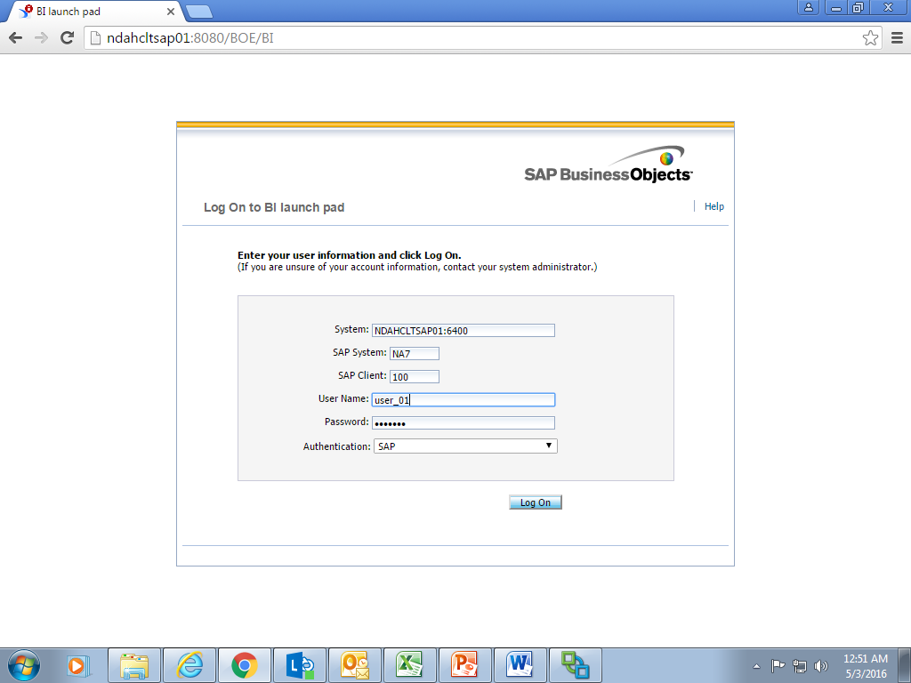
Navigate the interface
Login into BI launchpad (Infoview) using the credentials provided
http://ndahcltsap01:8080/BOE/BI
Launchpad is kind of an in-built browser to view all kinds of Reports in BOBJ and to access Web Intelligence

Slide 4
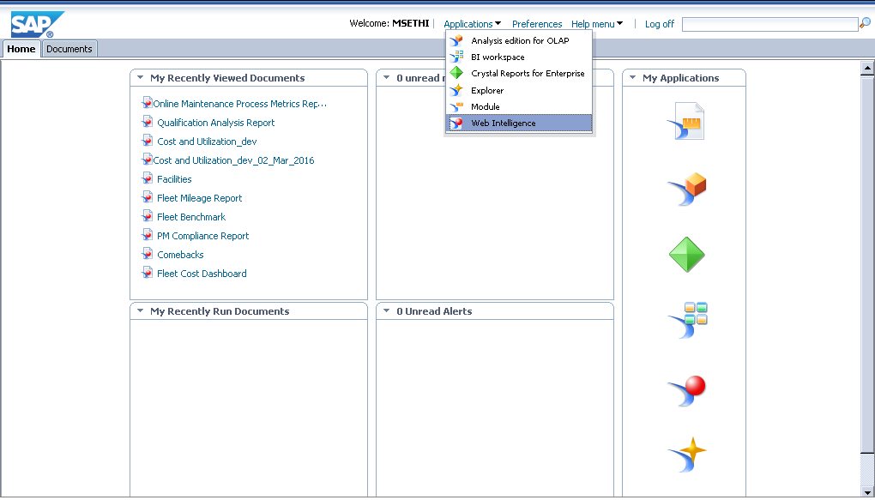
Navigate the interface
Home Page
My Applications will be display the applications to which you access in BI Launchpad

Slide 5
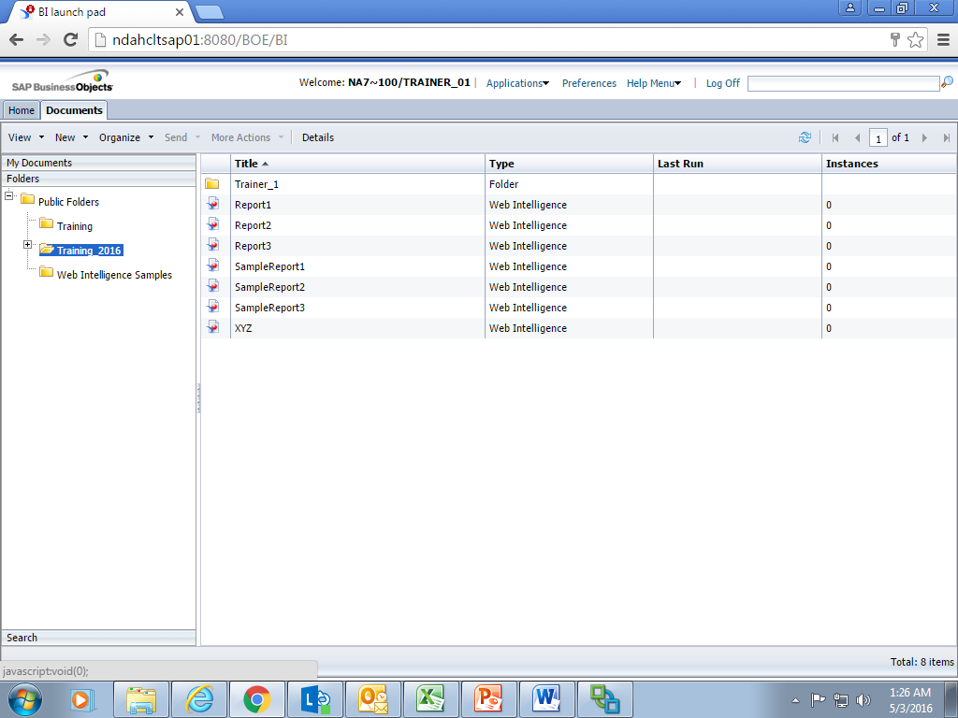
Navigate the interface
Document Tab > This displays the actual contents in the Repository and a users Personal folders. It can also be used to Search for repository objects.

Slide 6
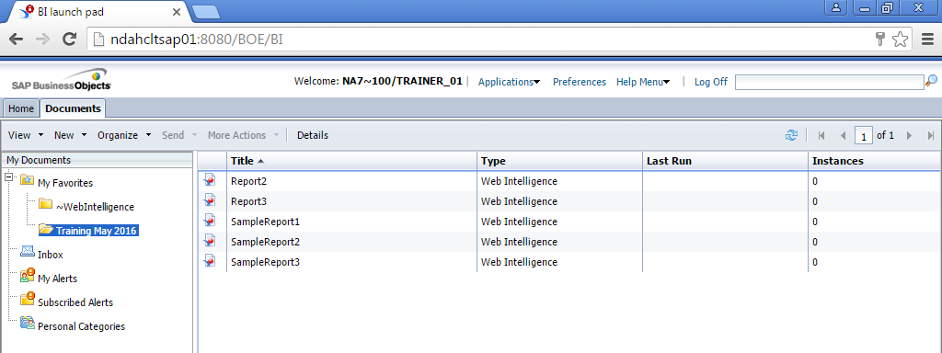
Navigate the interface
My Documents is your personal Folders where you can save copy of Reports, Personal Categories, Inbox.
You can save documents as a copy, shortcuts, modify them and save them in your My Favorites folder.
You can send receive documents from users through Inbox.

Slide 7
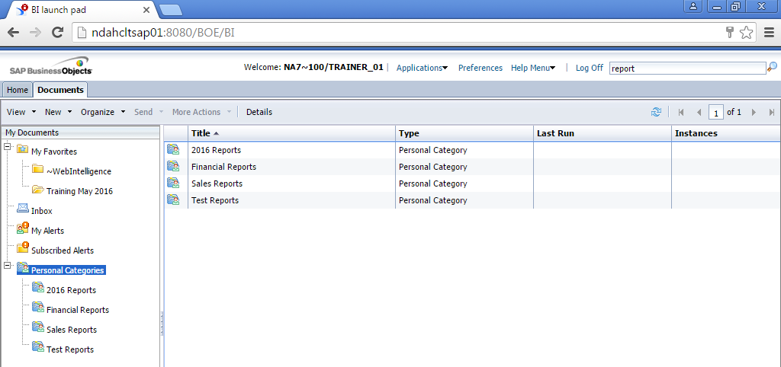
Navigate the interface
Categories is used for classification of documents based on Business needs.
One document can be assigned to more than one Category.
You can create your own Personal Categories and classify reports based on them.

Slide 8
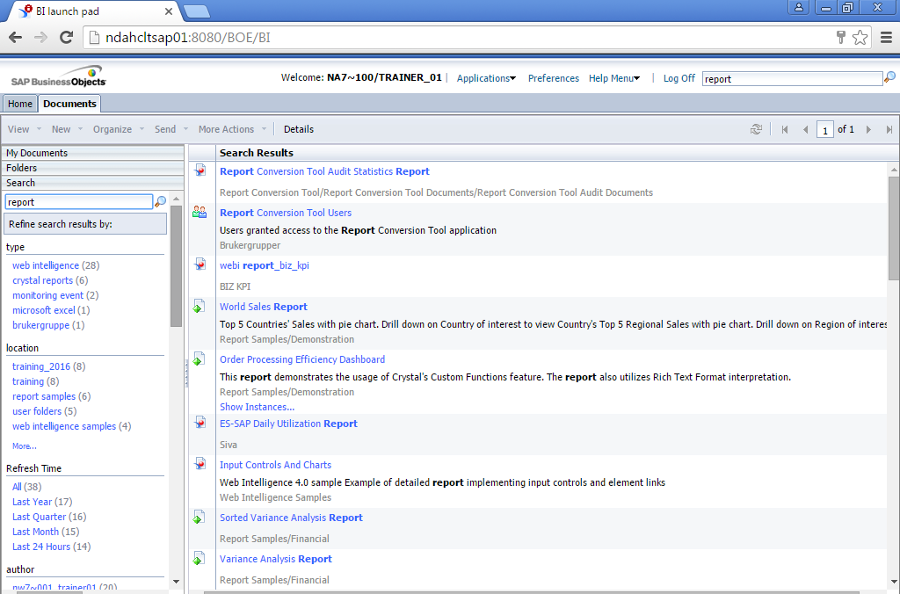
Navigate the interface
Search option in BI Launchpad
You can search based on type, location, last refresh time, author, data source

Slide 9
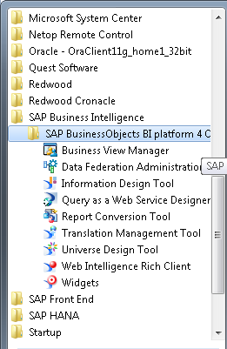
Web Intelligence Rich Client
Web Intelligence Rich Client is part of the Client tools that you have installed on your desktop. It is same as the WebI accessed from BI Launchpad.

Slide 10
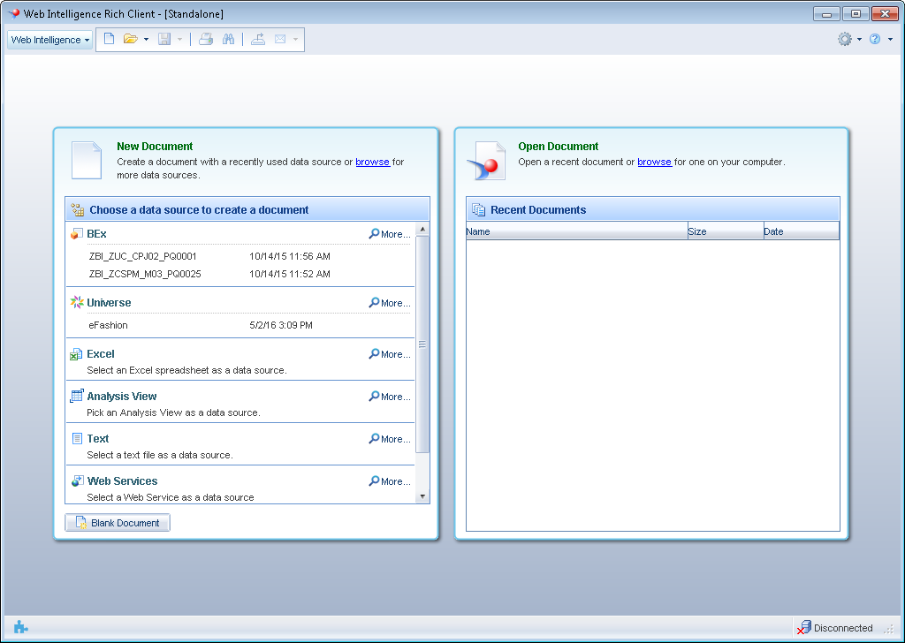
Web Intelligence Rich Client
Web Intelligence Home screen

Slide 11
My Applications
My Application displays all the applications to which you have access.
Web Intelligence, Explorer, Analysis Edition for OLAP are most commonly used applications.
Notes:
Web Intelligence is used for creating, viewing, modifying Webi Reports.
Analysis Edition for OLAP is used to create Analysis workspaces in BOBJ repository using BICS connections to use the Infoproviders available for Analysis through BI launchpad without having to access BW applications.
Explorer is an Analysis tool used for analyzing the Information sets available in the BOBJ repository.

Slide 12
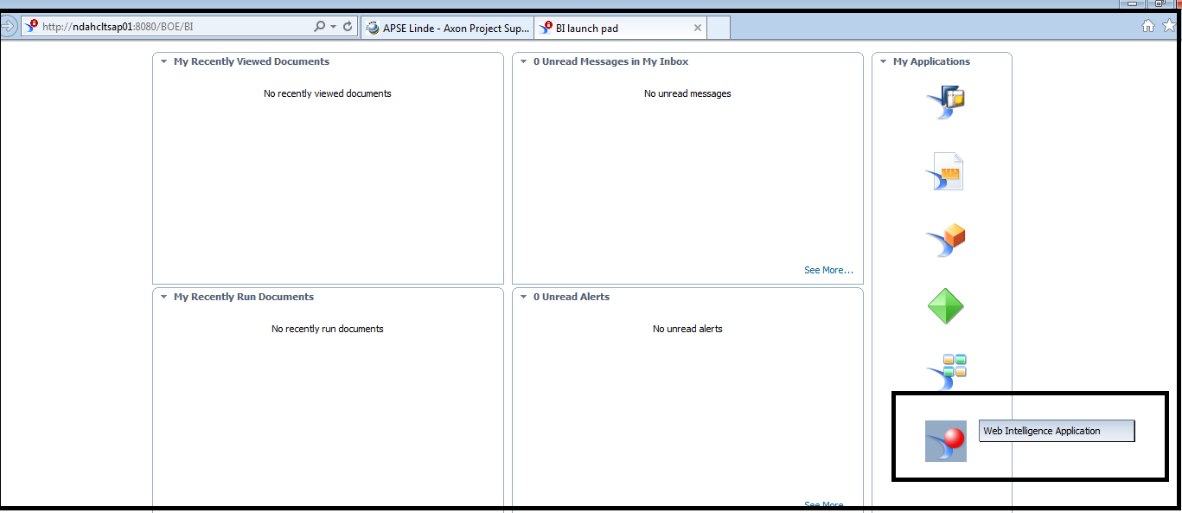
Creating a New Web Intelligence Report
Select Web Intelligence from the My Applications list.

Slide 13
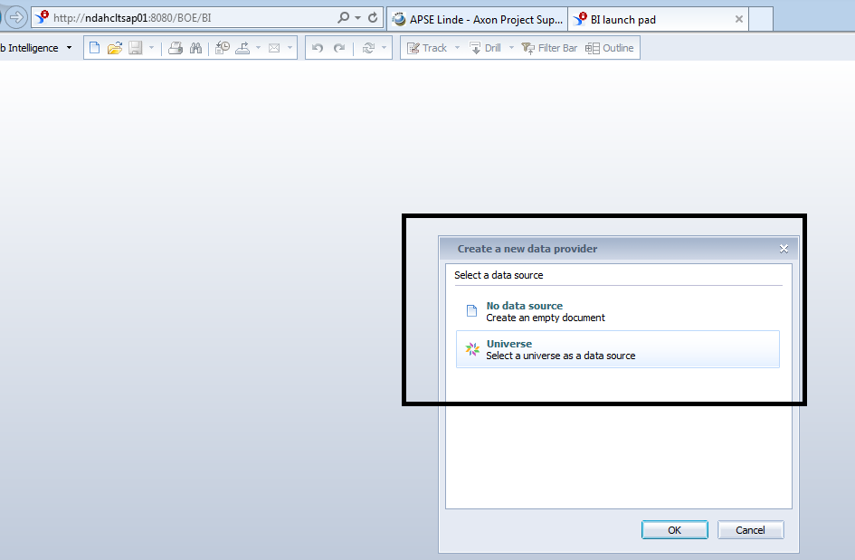
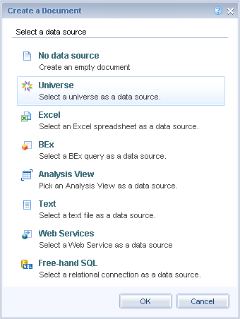
Creating a New Web Intelligence Report
Click on New to create a new Web Intelligence Report.
It will prompt you to select a data source.
Options are Universe, Excel, Bex, Free hand SQL, etc.
Available data source options depends on your security rights in the system.

Slide 14
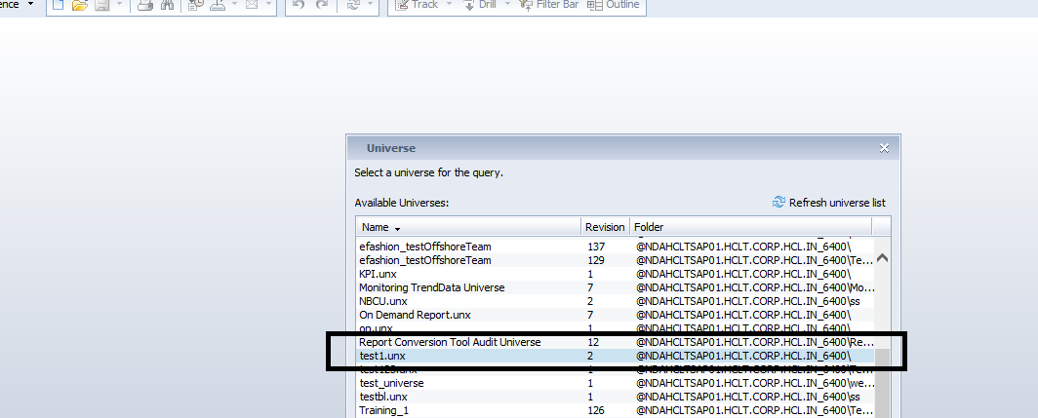
Creating a New Web Intelligence Report
Select Data source as Universes, It will provide you the list of all Universes to which you have access.
Select the desired Universe from the list of Universes.
Notice that Universes display Name, revision (version) and Folder.

Slide 15
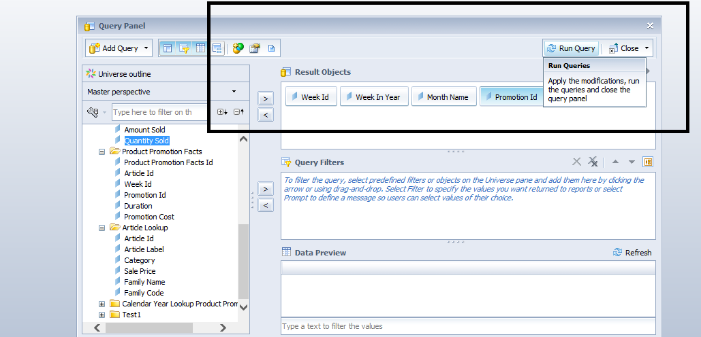
Creating a New Web Intelligence Report
Query Panel appears which displays the Business Layer of the Universe.
Business Layer appears on the Left side of the panel.
Right side displays the selection panels: Result (Select clause), Filters (Where clause), Preview, etc.
Add objects in Result Objects for which you want the result output.

Slide 16
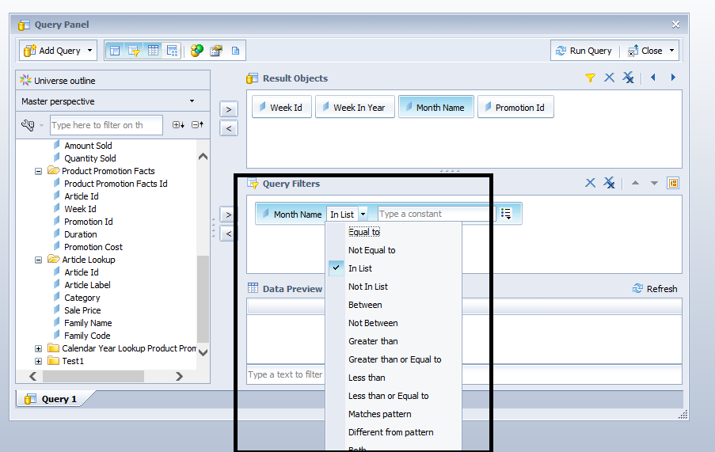
Creating a New Web Intelligence Report
Apply Filters in the query panel.
You will get option to select the operator from list of operators and also for selecting the value.

Slide 17
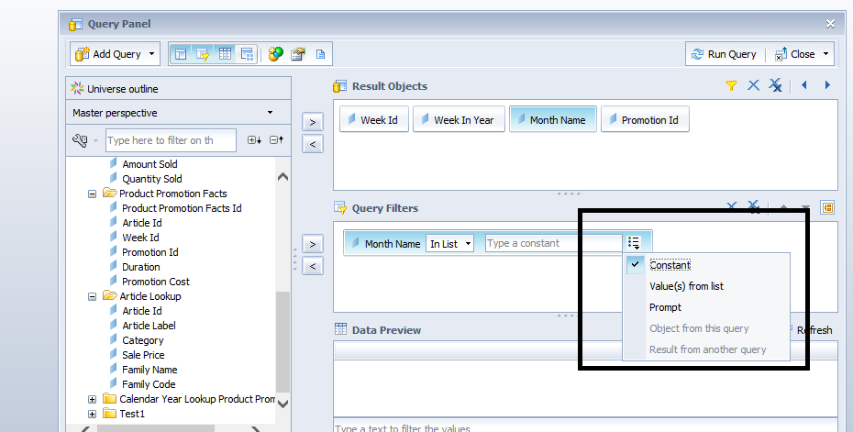
Creating a New Web Intelligence Report
Query Filter options displays how you want to put the value.
If a constant value needs to be applied, it can directly be typed.
Values from List displays values available in data source and are applied as selected.
Prompt allows the users to ask the user for values at runtime only.

Slide 18
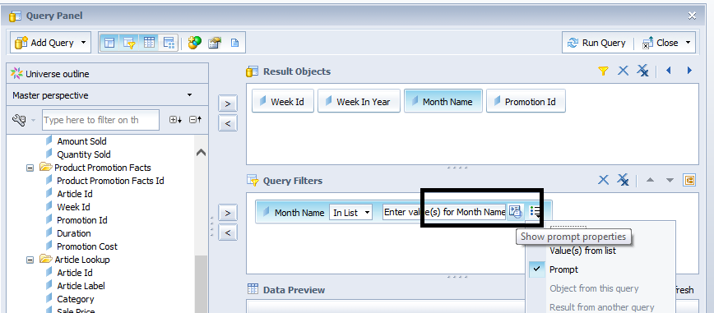
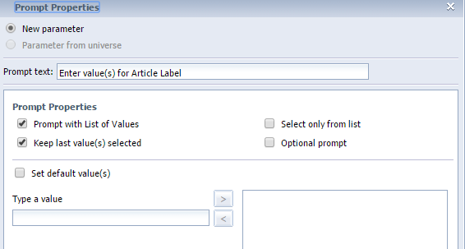
Creating a New Web Intelligence Report
Prompt allows the users to select the message to display when the prompt appears at runtime.
It also provides options like if it should prompt with the List of values, setting default value, Optional/Mandatory prompt, select only from list and custom LOV’s.

Slide 19
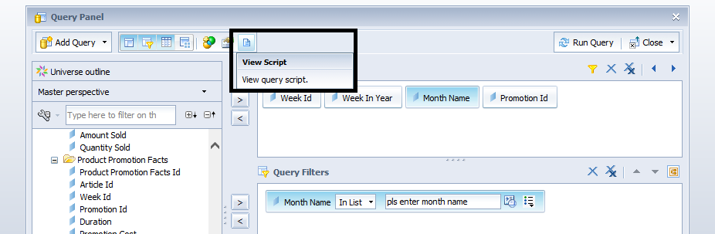
Creating a New Web Intelligence Report
Click on View Script at the top of the Query Panel to view the resulting SQL of the query.
It will include Select statement (coming from the Result Objects), Joins (as defined in the Universe), Where clause (as coming from Universe and Query Filters in query panel).

Slide 20
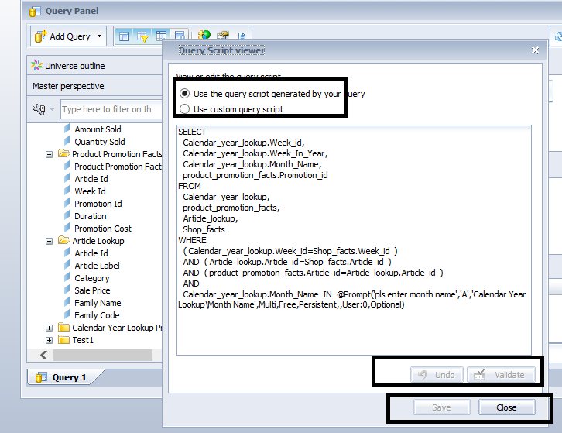
Creating a New Web Intelligence Report
If required you can modify the query as per you requirement and need to Validate and Save it. This is not recommended as it overrides the query generated by Universe and in case errors exist in the query it might cause performance issues in the report.
Notes:
If you click on the default option it will remove the Custom query create by you and will display the query generate as per the Universe design.

Slide 21
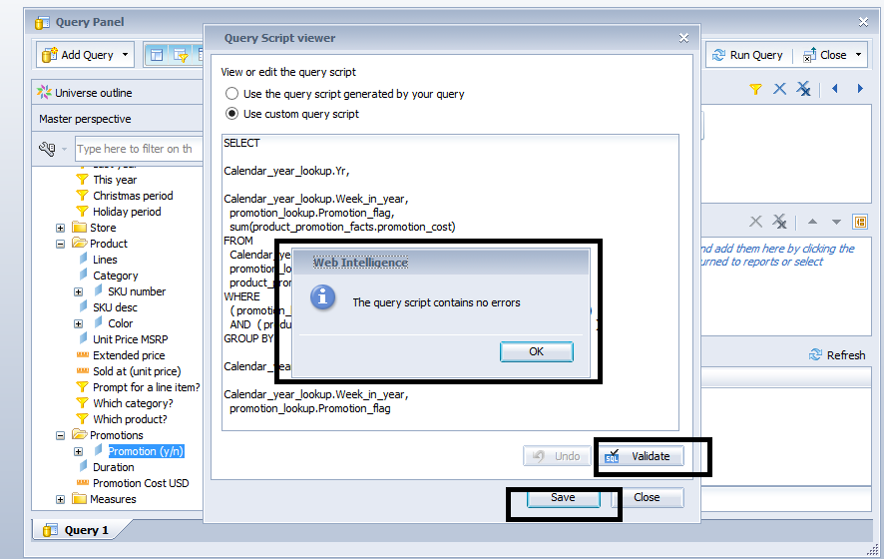
Creating a New Web Intelligence Report
Using Custom SQL is not recommended and should be avoided.

Slide 22
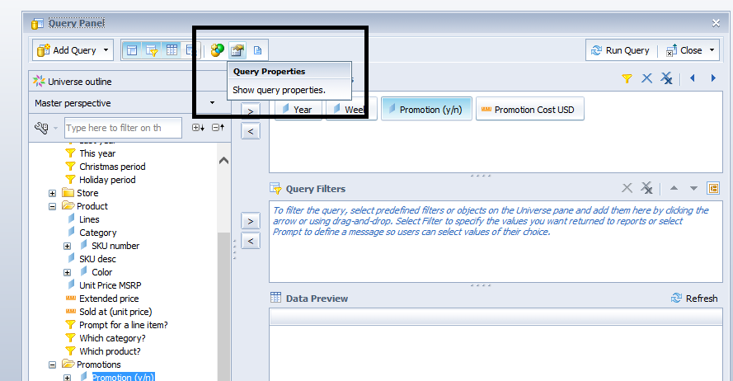
Creating a New Web Intelligence Report
Modifying query properties

Slide 23
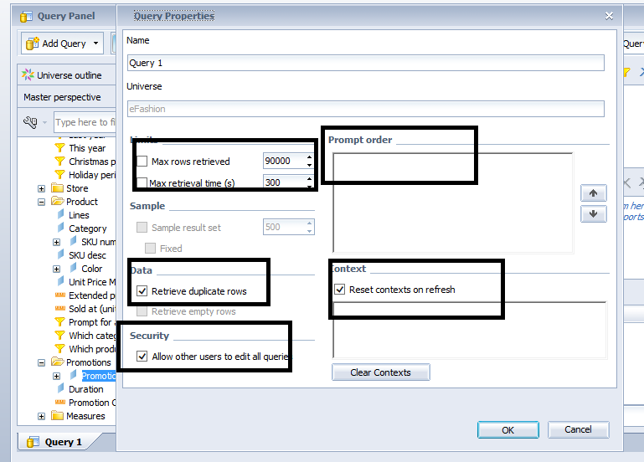
Creating a New Web Intelligence Report
Query properties displays Query and Universe Name, Prompt order, Max rows and time restrictions. Data duplicity and Security can also be managed from here.
Context selection can also be done from the properties.

Slide 24
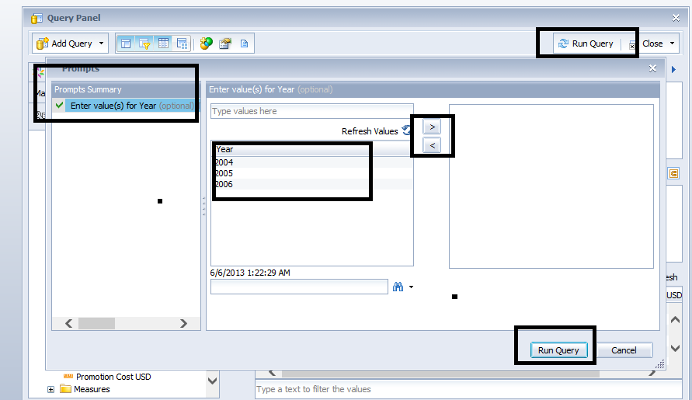
Creating a New Web Intelligence Report
Running the query with prompts will request you to select the prompt values which will be applied on the query at runtime.
The prompt values are sent to the data source (DB, OLAP, etc.) and helps with query performance.

Slide 25
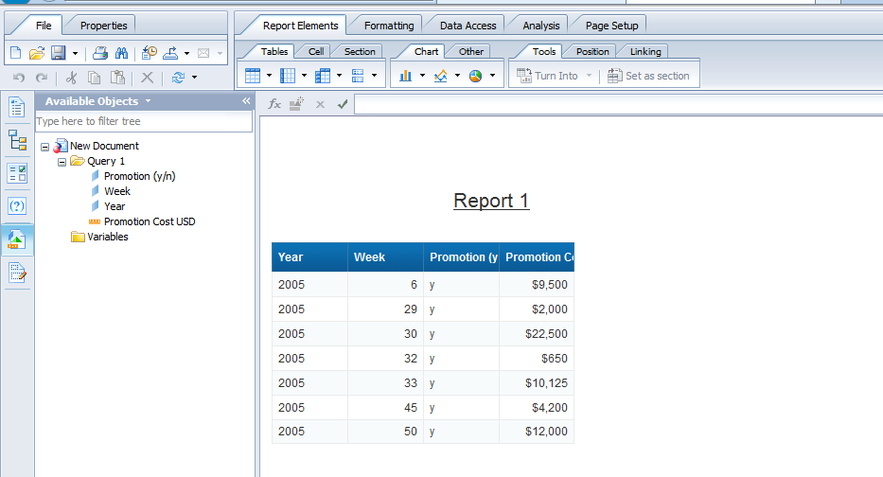
Creating a New Web Intelligence Report
Query runs successfully and result is displayed in the form of a table as shown.

Slide 26
  The End

